Slide 1
Survival on the Titanic: The Impact of Class and Gender
An analysis of how class and gender influenced survival rates on the RMS Titanic

Slide 2
Introduction
On the night of April 14, 1912, the RMS Titanic met its tragic end. Among the chaos and despair, patterns emerged from the survival data that reveal much about the social dynamics of the time. This story explores how class and gender influenced the chances of survival during one of the most infamous maritime disasters in history.

Slide 3
Thesis Statement
The survival rates of Titanic passengers were significantly influenced by their class and gender, revealing stark contrasts in the chances of survival based on these factors.

Slide 4
Data and Analysis
We analyzed the Titanic passenger dataset, focusing on the survival rates across different classes and genders. Here's what we found:
- Overall Survival Rate: 38.38%
- Survival Rate by Gender: 74.20% for females, 18.89% for males
- Survival Rate by Class: 62.96% for 1st class, 47.28% for 2nd class, 24.24% for 3rd class

Slide 5
Visualizations
1. Bar Chart: Survival rates by class and gender
2. Pie Chart: Overall survival distribution
3. Line Graph: Survival rates across different age groups

Slide 6
Narrative: The Stories of Six Personas
1. Elisabeth Walton Allen (First Class, Female, Age: 29, Survival Rate: 96.81%)
Elisabeth was one of the fortunate few in first class. The night of the disaster, she was quickly ushered to a lifeboat due to the 'women and children first' protocol. Her survival is a testament to the privileges afforded by her class and gender.
2. Hudson Trevor Allison (First Class, Male, Age: 30, Survival Rate: 33.33%)
Hudson, despite his wealth and status, faced a grim fate. As a first-class male, his chances of survival were drastically lower compared to females in the same class. He perished, highlighting the harsh realities of the era's gender norms.
3. Emily Borie Ryerson (Second Class, Female, Age: 24, Survival Rate: 84.40%)
Emily, a young woman in second class, found a spot in a lifeboat. Her youth and gender played crucial roles in her survival. Emily's story is one of hope amidst tragedy, where social hierarchies dictated life and death.
4. Edgar Samuel Andrew (Second Class, Male, Age: 25, Survival Rate: 15.73%)
Edgar's journey ended in heartbreak. Despite being in second class, his chance of survival was significantly low due to his gender. His story reflects the peril faced by men who adhered to the societal expectation of sacrificing their lives.
5. Kate McGowan (Third Class, Female, Age: 23, Survival Rate: 46.15%)
Kate, a third-class passenger, faced a challenging fight for survival. The lower survival rate for third-class women shows the compounded disadvantages of being both poor and female. Yet, Kate's resilience saw her through the night.
6. Johan Svensson (Third Class, Male, Age: 32, Survival Rate: 13.54%)
Johan's fate was sealed by his class and gender. As a third-class male, his chance of survival was among the lowest. Johan's story is a somber reminder of the inequities faced by those at the bottom of the social hierarchy.

Slide 7
Elisabeth Walton Allen (First Class, Female, Age: 29)
Quote: "As I was guided to the lifeboat, the reality of our fragile existence struck me. In that moment, I realized how our lives hinged on the luck of our circumstances."
Hudson Trevor Allison (First Class, Male, Age: 30)
Quote: "I knew my duty was to stay back, allowing the women and children their chance. The weight of class and privilege meant little in the face of the icy abyss."
Emily Borie Ryerson (Second Class, Female, Age: 24)
Quote: "In the darkness, amidst the panic, it was hope that kept me afloat. Hope that I would see my family again, and that somehow, I would survive this night."
Edgar Samuel Andrew (Second Class, Male, Age: 25)
Quote: "There was no choice but to act with courage. As I helped others, I couldn't help but think of the life that awaited me, if only I could make it through."
Kate McGowan (Third Class, Female, Age: 23)
Quote: "The cold was unbearable, but the will to survive was stronger. I clung to the thought of a better life, and that thought pulled me through the darkest hours."
Johan Svensson (Third Class, Male, Age: 32)
Quote: "Survival was a distant hope, but I fought for every breath. In those final moments, it wasn't fear that consumed me, but a profound sense of resolve to live."

Slide 8
Conclusion
The Titanic disaster starkly illustrated the disparities in survival chances based on class and gender. First-class women had the highest survival rates, while third-class men had the lowest. These personas, representative of real passengers, bring to light the human stories behind the statistics.

Slide 9
Call to Action
Reflect on these stories and consider the progress made in terms of social equity. Let the lessons of the Titanic remind us to strive for a world where opportunities for survival and success are not dictated by one's social standing or gender.

Slide 10
Supporting Materials
- Data Source: Titanic passenger dataset
- References: Historical accounts of Titanic passengers and their fates

Slide 11
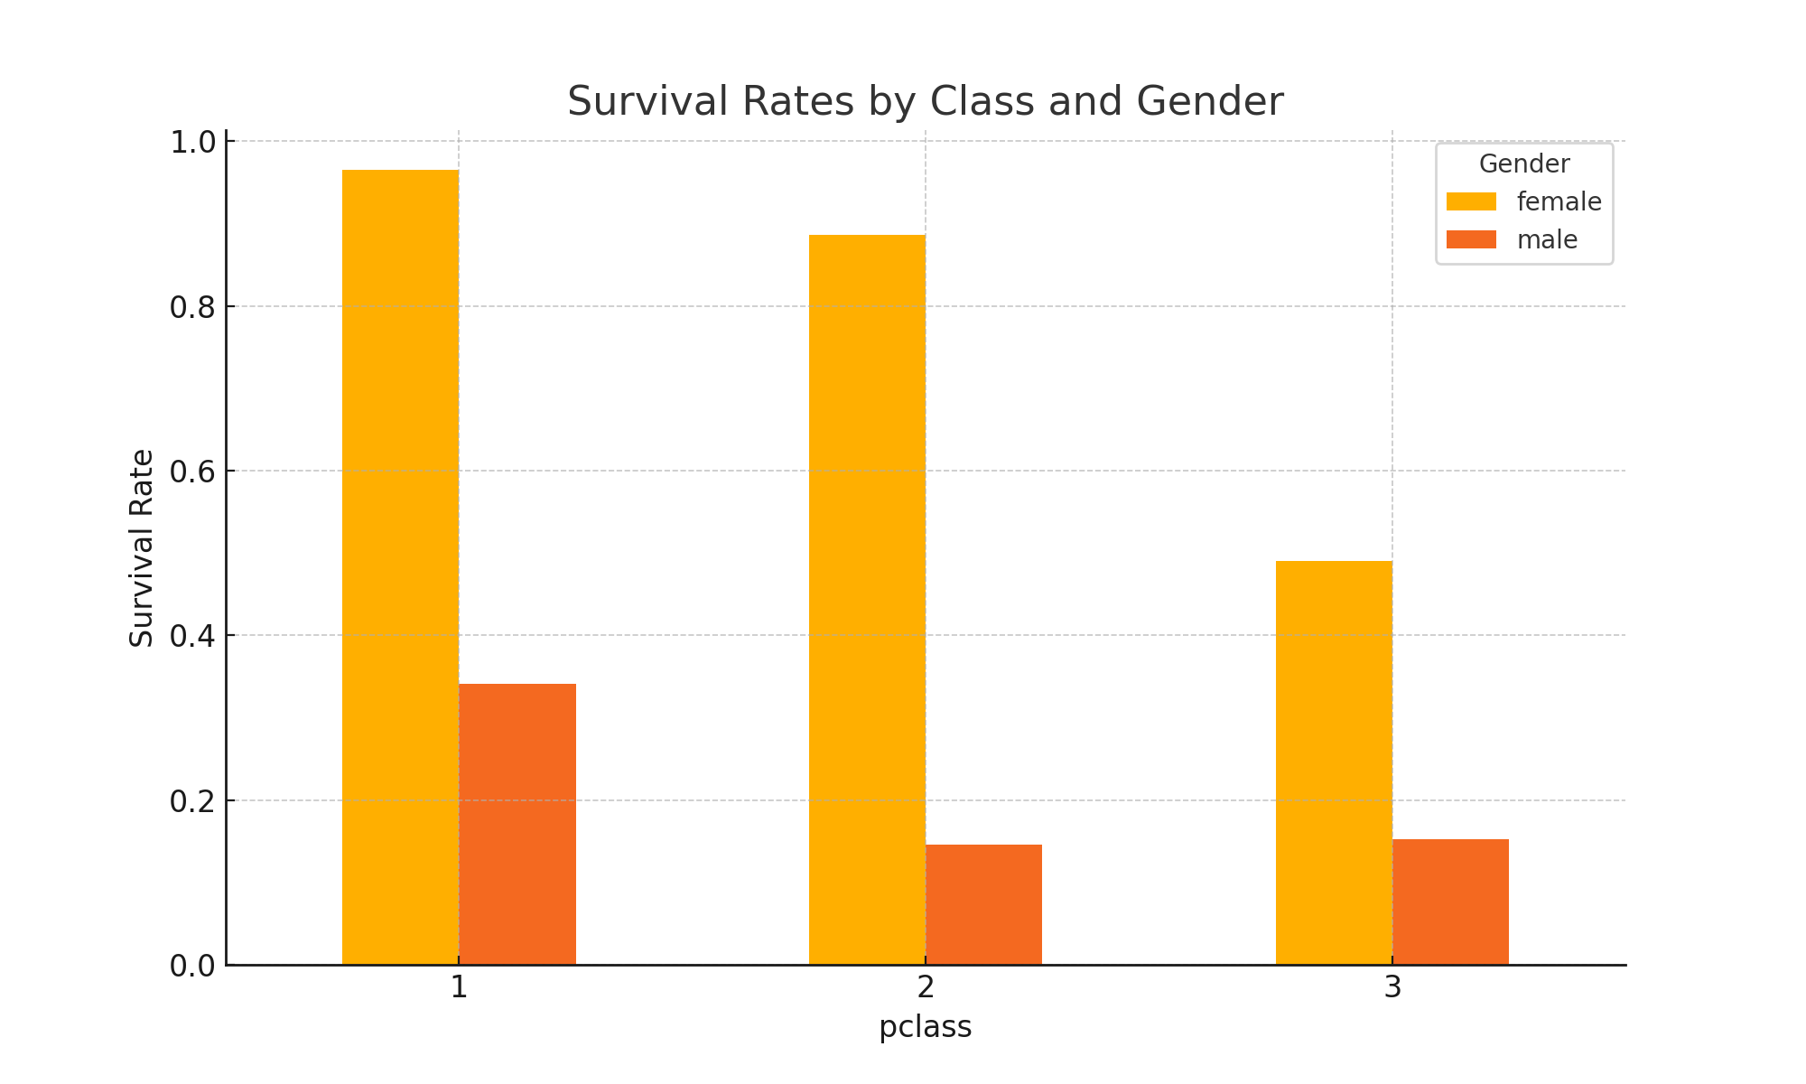
Survival Rates by Class and Gender

Slide 12
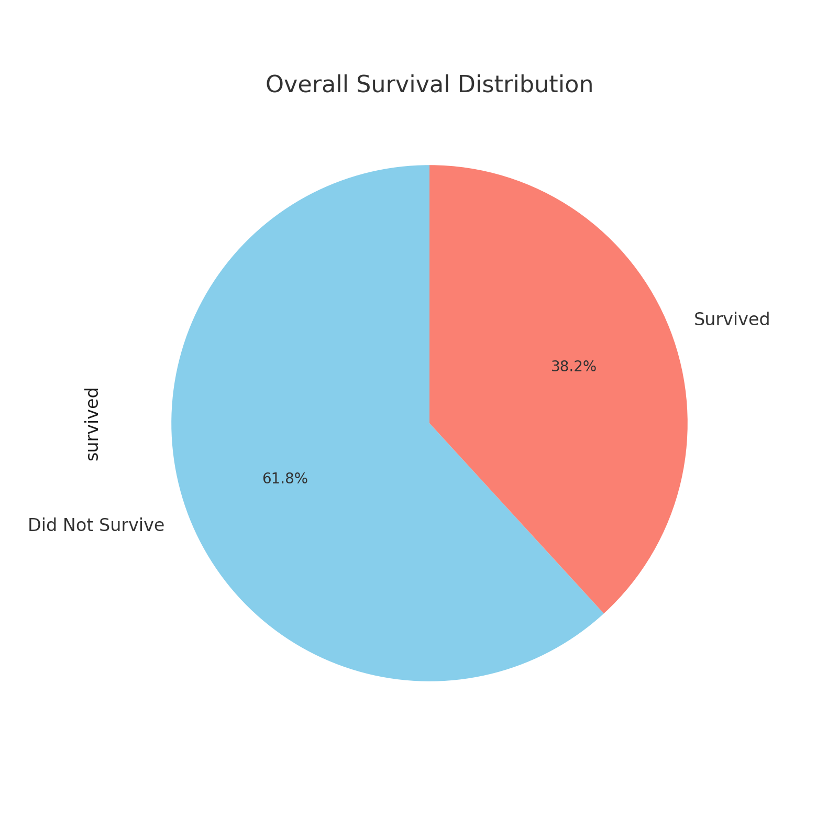
Overall Survival Distribution

Slide 13
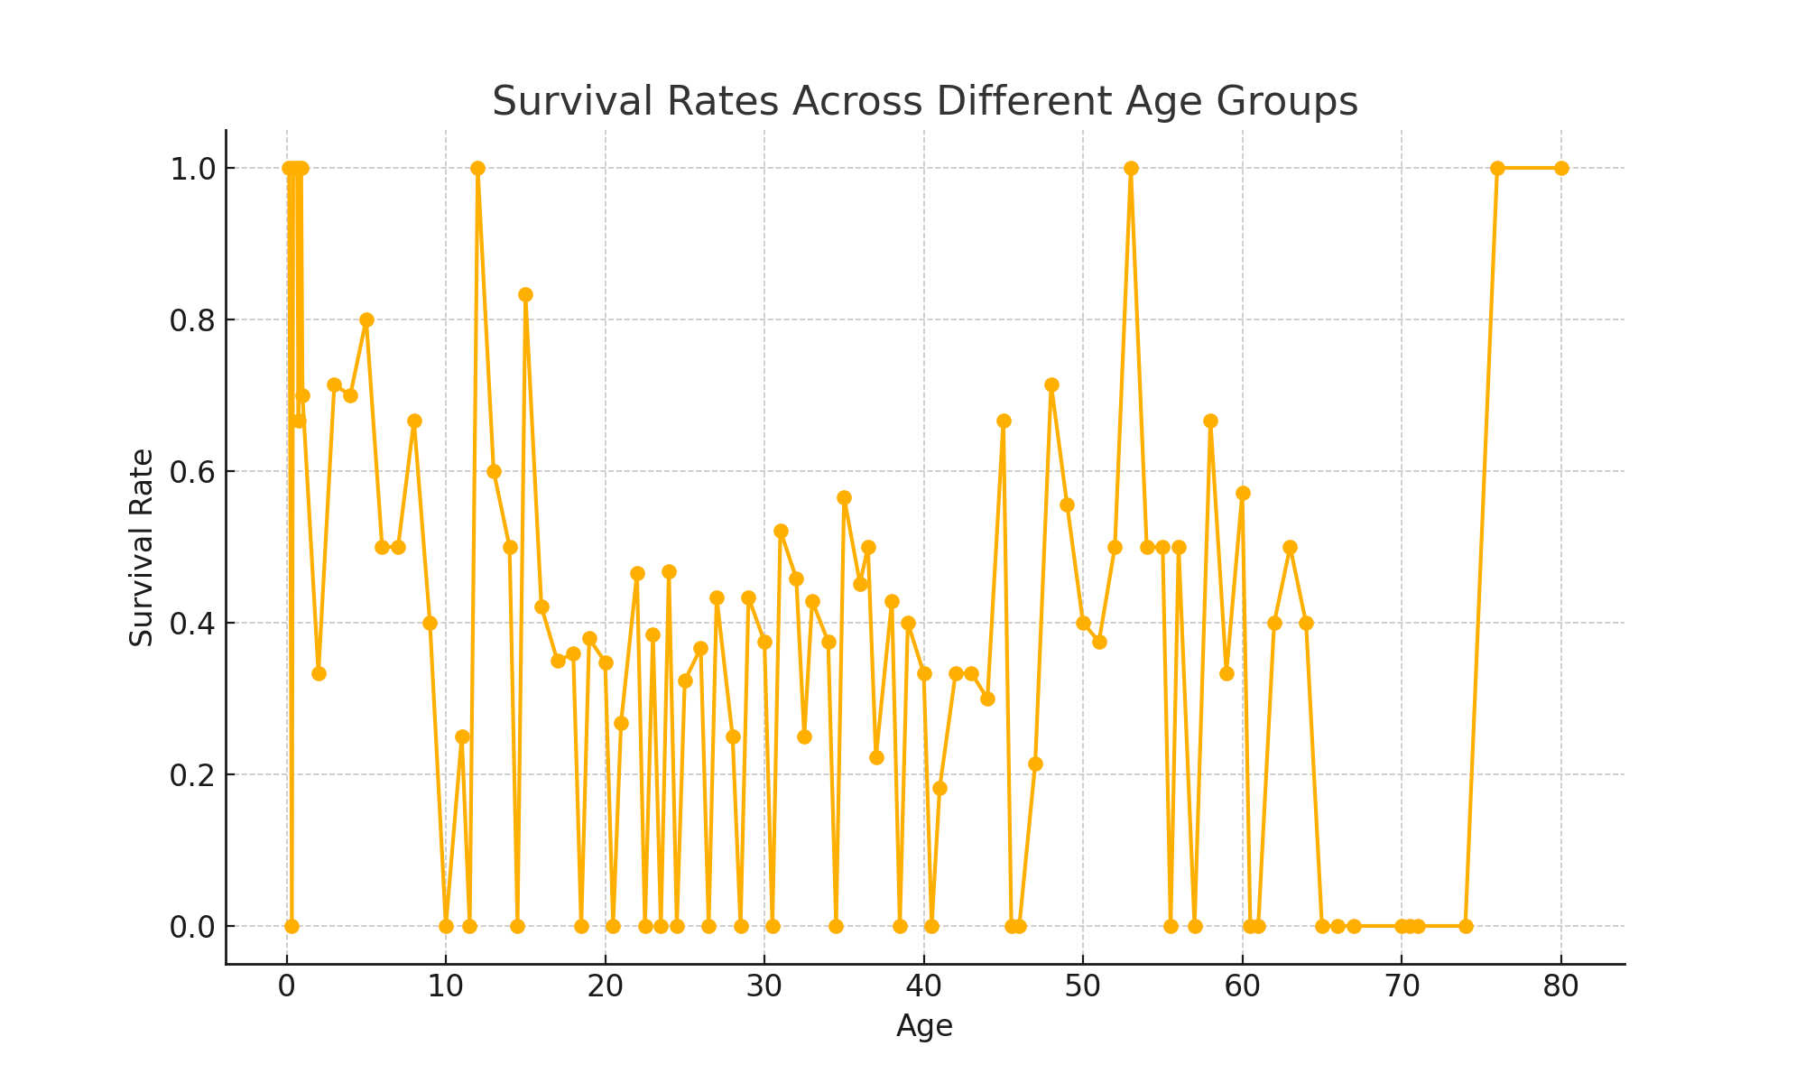
Survival Rates Across Different Age Groups

Slide 14

Elisabeth Walton Allen

Slide 15

Hudson Trevor Allison

Slide 16

Emily Borie Ryerson

Slide 17

Edgar Samuel Andrew

Slide 18

Kate McGowan

Slide 19

Johan Svensson

